Slide 1
How to be a good Open Source community member
Reza Shalbafzadeh
@shalbafzadeh
ZCONF - 7th National FOSS Conference

Slide 2
What is Community?
Communities are groups of individuals sharing common interests.
We are “The Community”

Slide 3
Why does it matter?
It drives projects
It's what empowers projects
It benefits everyone

Slide 4


Slide 5
But...
-“Am I allowed?”
-”Beyond me ?”
-”Will they get offended?”
-”My code isn't good enough!”
-”Someone else will fix it”
They’re all wrong...

Slide 6
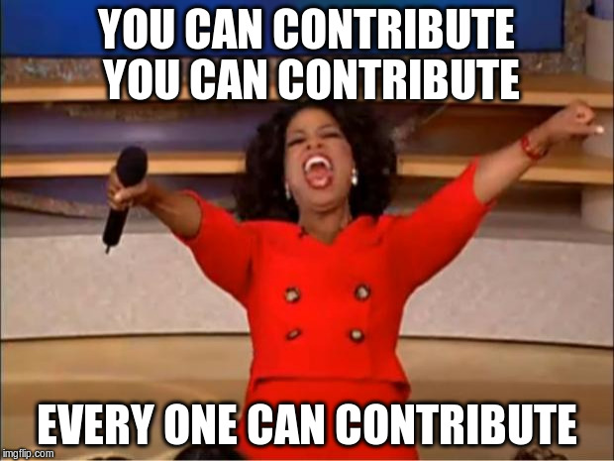
So...Can I Contribute too?

Slide 7

But I’m not a programmer :(

Slide 8
Software is not just Code!
Use it
Advocate it
Read the source code
Read and Update documentation
Report issues
Donate!

Slide 9
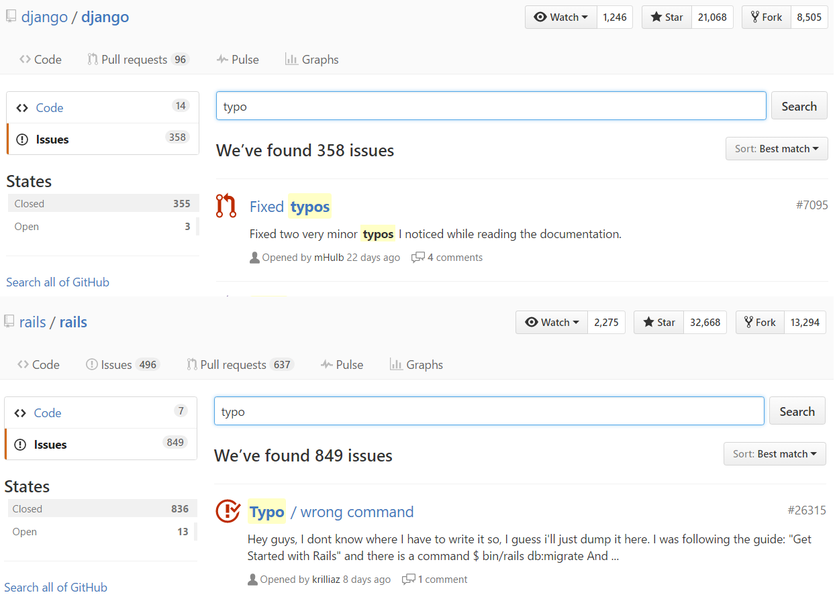
Even fixing typos counts as contribution
(no offense btw)

Slide 10
So... How to be a Good Open Source Community Member?
Respect everyone in the community
Dare and be curious (But always keep your manners!)
Read the documents
Read source code even you don't understand it completely
Search before asking your questions. (There is a 99 percent chance that the solution to your problem is a simple search away)
Be patient
Read it : how to ask smartly چگونه هوشمندانه سؤال کنیم

Slide 11
And if you've bootstrapped
Share your code even if they’re ugly or creepy
Volunteer to organize events and gatherings...No matter how small the size of your group is
Interact with other communities e.g. (TehPUG & TehLUG, TehLUG & KarajLUG )
Be friendly with newcomers
Help amateur enthusiasts.

Slide 12
Contribute To software
Confirm Issues and try to resolve them
Test cutting edge versions
Answer users’ Questions (SO,IRC, gitter etc.)
Contribute by coding
Discuss Your Idea it with other developers

Slide 13
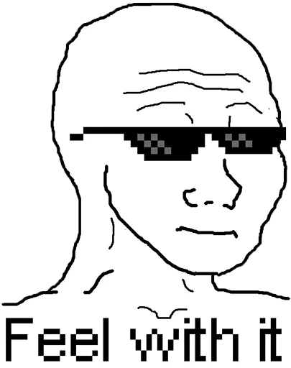
And the best thing here is...
IT FEELZ GOOD!

Slide 14
Questions?

Slide 15
Thanks to:
Javad Arjmandi (@JavadLV)
Mohammad Reza Kamalifard (@rezakamalifard)
AND YOU!

